Slide 1
Abstract
The underdiagnosis and the undertreatment of comorbidities of chronic obstructive pulmonary disorder (COPD) such as anxiety and depression are key issues in pulmonary care. Typically, primary care involves addressing physical health issues, such as COPD, which have a significant impact on patients. However, this does not adequately account for the overall well-being of patients. Anxiety and depression may have negative impact on patients’ quality of life and are likely to impede their ability to recover (Pooler & Beech, 2014). To address this, it is necessary to provide patients with access to mental health facilities. The change strategy proposed in this presentation is to provide cognitive behavior therapy (CBT) to patients by mental health professionals. Organizations could also train their nurses in CBT or hire nurses who are trained in CBT. The Deming Cycle, or the Plan-Do-Check-Act (PDCA) cycle, could be used to evaluate the efficacy of the strategy. The PDCA cycle would ensure that the change strategy is adequately evaluated in terms of whether it improves patients’ quality of life and their ability to cope both mentally and physically with COPD, anxiety, and depression.

Slide 2
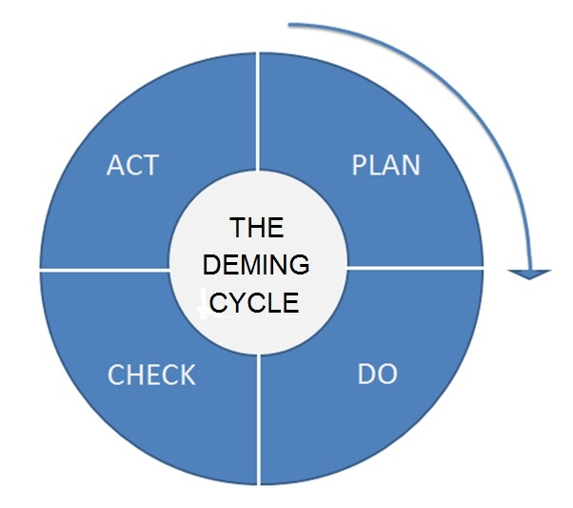
Quality Improvement Presentation Poster Learner’s Name Capella University Biopsychosocial Concepts for Advanced Nursing Practice I Quality Improvement Presentation Poster April, 2019
Quality Improvement Methods
Interprofessional Team Benefits
Quality improvement is the betterment of the desired outcomes of any existing process. Typically, this would require prior understanding of the process and aspects of it that require improvement. The PDCA cycle is one of the tools used in quality improvement (Pietrzak & Paliszkiewicz, 2015).
Once an area of improvement is identified, it is necessary to provide a plan of action to enhance the outcomes in that area. Primary care largely focuses on the physical health of patients. In pulmonary care, physicians and nurses typically focus on the physical symptoms that patients experience. However, COPD patients are often underdiagnosed and are undertreated for anxiety and depression (Pooler & Beech, 2014). These issues tend to impede patient recovery and deteriorate quality of life and health care outcomes.
After an area of improvement is identified, the plan of action would address the issue of insufficient care by providing COPD patients with adequate access to mental health facilities.
Once the plan of action is set, the next step is implementation. This is the “do” stage of the Deming Cycle. During this stage, it is necessary to execute the plan on a small scale to record its results and evaluate its efficacy.
The effects of the change implemented are then evaluated during the “check” stage of the PDCA cycle (Pietrzak & Paliszkiewicz, 2015). The key question to be asked at this stage is whether the change does what it purports to do. If it does, would the change positively affect patients’ recovery and capacity to self-manage their condition?
Based on the evaluation during the “check” stage, the quality improvement method is modified, and the cycle is repeated if the implemented change does not match the expected outcome. If the change proves to be effective, the quality improvement method is standardized and documented (Pietrzak & Paliszkiewicz, 2015).
The change strategy proposed here would involve teams of physicians, nurses, and mental health professionals.
These three teams would work together to coordinate the patient’s treatment. This would require consistent communication and cooperation between the teams.
Through an interprofessional collaboration, the teams would identify gaps in patient safety and improve coordination in implementing change strategies (Amalakuhan & Adams, 2015).
Overall Project Benefits
The evidence from the studies cited here indicates that an interprofessional approach that caters to COPD patients’ physical and psychological needs would improve their quality of life and aid their ability to self-manage and thereby recover from both issues.
Using the Deming Cycle, physicians, nurses, and mental health professionals could evaluate the outcomes of implementing a CBT program for COPD patients.
After the evaluation, if the quality improvement method suggested is found to result in optimal outcomes, the process could be standardized. If the outcomes are found to be suboptimal, then the process could be amended, and the Deming Cycle would begin again to ensure that quality improvement is an ongoing process.
By ensuring that quality improvement is an ongoing process, patients will receive care that is continuous and of high quality, and teams will be able to develop better communication and cooperation among themselves. Further, through a collaborative approach, physicians, nurses, and mental health professionals could identify gaps in patient safety during the implementation of change strategies.
Limitations of the PDCA Cycle
Knowledge Gaps and Unknowns
References
If the data received from the check phase is misinterpreted, people may arrive at inaccurate conclusions, leading to incorrect actions (Reed & Card, 2015).
In research conducted by Coury et al. (2017), it was found that when the PDCA Cycle is applied before a clinical intervention is fully implemented, the focus of the improvement process is likely to shift.
In the same research by Coury et al. (2017), it was observed that several clinicians commonly found it challenging to measure the success of the PDCA cycle using the electronic medical record tools available.
The cycle also focuses on observing and rectifying errors. It does not predict errors.
Amalakuhan, B., & Adams, S. G. (2015). Improving outcomes in chronic obstructive pulmonary disease: The role of the interprofessional approach. International Journal of Chronic Obstructive Pulmonary Disease, 10(1). 1225–1232.
Carvalho, F., Jun, G. T., & Mitchell, V. (2017). Participatory design for behaviour change: An integrative approach to healthcare quality improvement. Paper presented at IASDR 2017 Proceedings, 7th International Congress of the International Association of Societies of Design Research, Cincinnati, OH.
Coury, J., Schneider, J. L., Rivelli, J. S., Petrik, A. F., Seibel, E., D’Agostini, B., . . . Coronado, G. D. (2017). Applying the Plan-Do-Study-Act (PDSA) approach to a large pragmatic study involving safety net clinics. BMC Health Services Research, 17(411).
Donnelly, P., & Kirk, P. (2015). Use the PDSA model for effective change management. Education for Primary Care, 26(4), 279–281.
Heslop, K., Newton, J., Baker, C., Burns, G., Carrick-Sen, D., & De Soyza, A. (2013). Effectiveness of cognitive behavioural therapy (CBT) interventions for anxiety in patients with chronic obstructive pulmonary disease (COPD) undertaken by respiratory nurses: The COPD CBT CARE study: (ISRCTN55206395). BMC Pulmonary Medicine, 13(1).
Howard, C., & Dupont, S. (2014). ‘The COPD breathlessness manual’: A randomised controlled trial to test a cognitive-behavioural manual versus information booklets on health service use, mood and health status, in patients with chronic obstructive pulmonary disease. npj Primary Care Respiratory Medicine, 24.
Kliem, R. L. (2015). Managing Lean Projects. Boca Raton, FL: CRC Press.
Pietrzak, M., & Paliszkiewicz, J. (2015). Framework of strategic learning: The PDCA cycle. Management, 10(2), 149–161.
Pooler, A., & Beech, R. (2014). Examining the relationship between anxiety and depression and exacerbations of COPD which result in hospital admission: A systematic review. International Journal of Chronic Obstructive Pulmonary Disease, 9(1), 315–330.
Reed, J. E., & Card, A. J. (2015). The problem with Plan-Do-Study-Act cycles. BMJ Quality & Safety, 25(3), 147–52.
The PDCA cycle itself cannot guarantee quality improvement. The process of achieving a solution is slow and may not be linear. The cycle focuses on learning and taking informed actions. Adapting the cycle to different problems may not be simple and may require extensive skills and knowledge (Reed & Card, 2015).
Insufficient planning may lead to failure in achieving desired results (Reed & Card, 2015).
Strategies of the PDCA cycle also require scenarios that are not necessarily realistic (Pietrzak & Paliszkiewicz, 2015). When applied to realistic scenarios, these strategies could lead to failure, thereby creating more problems or adding to existing ones.
To arrive at a solution to a problem, the four-step process has to be repeated several times. An iterative process could result in slow progress (Kliem, 2015). Therefore, the cycle may be ineffective at achieving swift results in emergencies (Reed & Card, 2015).
Change Strategy Foundation
Patients who suffer from COPD are often comorbid with anxiety and depression. These conditions are likely to impede their recovery (Pooler & Beech, 2014). For instance, shortness of breath is a symptom that is common to both COPD and anxiety and can be distressing for the patient. A COPD patient who also presents with anxiety might interpret shortness of breath in an exaggerated manner, associating it with an inability to breathe or imminent death (Heslop et al., 2013).
If a COPD patient’s anxiety or depression is left untreated, it can significantly impact his or her compliance with COPD treatment. Anxiety and depression can affect a patient’s cognitive functioning and his or her ability to self-manage the condition (Pooler & Beech, 2014).
According to research conducted by Howard and Dupont (2014), COPD patients who received treatment for anxiety and depression coped with physical and mental conditions much better than patients who do not receive treatment.
Evidence Supporting QI Methods
In health care, quality improvement comprises continuous, combined efforts by patients, professionals, researchers, and institutes to improve processes toward better patient care, health care outcomes, systems of care, and professional development (Carvalho, Jun, & Mitchell, 2017).
The Deming Cycle, or the PDCA cycle, is a useful tool for quality improvement as it focuses on the creation of a plan followed by its execution and the evaluation of its results. By following this process, organizations can identify the shortcomings of the assumptions that their change strategies are based on and rectify those shortcomings. The PDCA cycle also provides a structure for teams to initiate change from within the system. The framework of the PDCA cycle ensures that the objective of any change process is within sight at all times and that the improvement that a process achieves is visible (Donnelly & Kirk, 2015).
Potential Challenges
COPD patients require access to therapists trained in CBT. It might be difficult to conduct one-on-one sessions for every patient; therefore, organizations could train their nurses in CBT or hire nurses who are trained in CBT.
Helping COPD patients achieve sustainable improvement in quality of life, functioning, and general physical condition can be challenging. Group therapy sessions can help patients talk about and cope with both physical and psychological issues. Providing COPD patients with access to CBT along with their regular treatments is likely to improve their quality of life and capacity to self-manage their condition (Pietrzak & Paliszkiewicz, 2015; Pooler & Beech, 2014).

